Slide 1
Private Rented Housing Consultation event
London Borough of Waltham Forest
28 February 2024

Slide 2
Welcome & Introductions – Julia Morris, AD Regulatory Services
Introduction to session
Purpose of session
Participants
Structure of session
Housekeeping
Further information regarding the property licensing consultation can be viewed on the web pages at https://www.walthamforest.gov.uk/consultations/property-licensing-consultation (numbers referenced in red relate to page numbers in the consultation document ‘Improving the Private Rented Sector in Waltham Forest’)

Slide 3
Agenda
Property Licensing Consultation presentation:
What is property licensing? Licensing regime overview
Current licensing schemes in Waltham Forest
Criteria relevant to proposed new licensing designations
Proposed new licensing schemes including scope and alternatives considered
Proposed scheme objectives
Proposed licence fee and discounts
Proposed licence conditions
Issues raised at Landlord Forum of 23 January 2024
Responding to the consultation
Next steps
Q&A session

Slide 4
What is property licensing?; property licensing overview (14/15)
Where property licensing applies to an address, it must be licensed in order to be legally let
Where on application a licence is granted, the Licence Holder (or another identified person) must comply with a set of licence conditions – this means that it is necessary to proactively manage and maintain the rented home e.g. by carrying out regular inspections
There are 3 licensing regimes, 1 of which is a mandatory scheme for certain Houses in Multiple Occupation (HMOs). The other 2 schemes are discretionary – local authorities can introduce these if certain criteria are met
For all schemes, there are nationally prescribed exemptions

Slide 5
Current property licensing schemes in Waltham Forest (17)
In addition to national mandatory HMO licensing, there are two large-scale discretionary schemes in force:
A borough-wide additional HMO licensing scheme which applies to most HMOs that do not come within the scope of mandatory licensing. This scheme is scheduled to end on 31 March 2025
A selective licensing scheme covering 18 of 20 wards that existed before the subsequent boundary changes. Hatch Lane and Endlebury wards are excluded. This scheme is scheduled to end on 30 April 2025.
This consultation relates to proposals to introduce new discretionary additional and selective licensing schemes when the current schemes end

Slide 6
Current property licensing schemes in Waltham Forest (2) (18/19)
For the current licensing schemes, the Council has:
Received ~27k licence applications
Granted >23k property licences
Refused or granted reduced term licences for ~2k properties
Inspected >8k privately rented homes
Overseen improvements at >1.7k homes
Despite progress made, the evidence indicates that is more that needs to be done in tackling issues in the private rented sector
Licence applications and decisions

Slide 7
Current property licensing schemes in Waltham Forest (3) (19/22/23)
Support for landlords and tenants
Enforcement action
The Council has used the full range of available enforcement powers where necessary to address non-compliance including the service of formal notices, prosecution or financial penalties of up to £30k

Slide 8
Private Rented Sector in Waltham Forest – current position (29/40)
Property Condition
It is estimated that over 7,400 private rented properties (27%) have at least one serious category 1 hazard or category 2 damp or excess cold hazard in the proposed designation.
Grove Green (637), St James (626) and Hoe Street (547) have the highest estimated number of properties with serious hazards. Proportionally, Markhouse (37%), St James (33%) and Leyton (33%) have the highest estimated levels of serious hazards.
Anti-social behaviour (ASB)
The PRS has the highest proportion of properties with persistent ASB (23% of PRS properties with persistent ASB) compared with persistent ASB in other tenure types in Waltham Forest (21% of owner occupier properties, 12% of housing association properties and 14% of local authority properties).

Slide 9
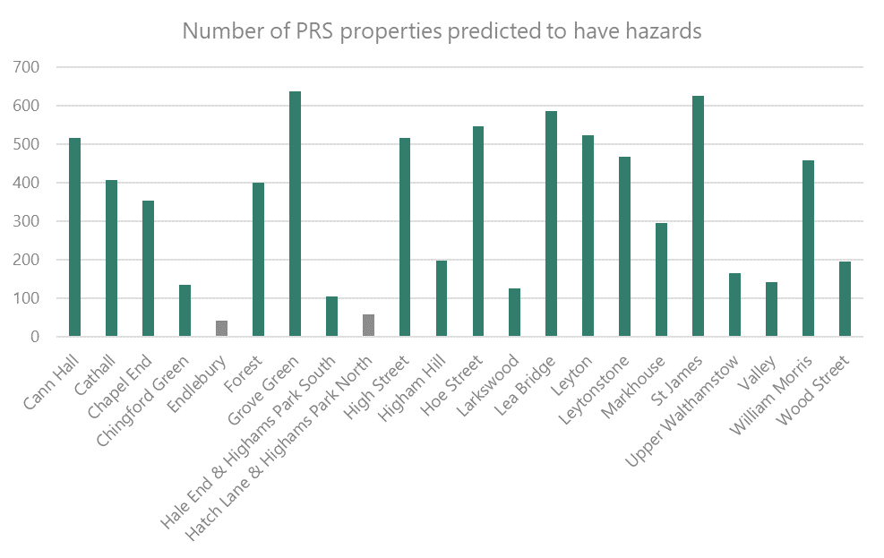
Private Rented Sector in Waltham Forest – property condition (30)

Slide 10
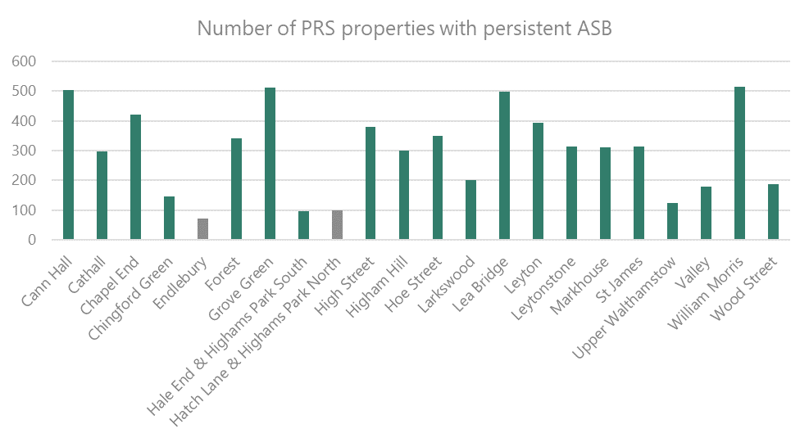
Private Rented Sector in Waltham Forest – ASB (42)

Slide 11
HMOs in Waltham Forest – current position (46/47)
Property Condition
Poor housing conditions are prevalent in Waltham Forest’s HMOs. The evidence shows that nearly one fifth (19%) of HMOs have serious (category 1) hazards, and over half (53%) have category 2 hazards. Converted building HMOs are also usually older houses or buildings converted into flats either under considerably older legal standards, or without any consideration of building standards. Common issues found in all types of HMO are a lack of adequate fire and electrical safety measures, inadequate amenities, overcrowding and damp and mould.
Anti-social behaviour (ASB)
HMOs in Waltham Forest have the highest proportion of properties with repeat ASB compared with other tenure types.

Slide 12
Proposed licensing schemes (25/46)
Selective licensing scheme
A designation covering the 20 of the 22 wards in the Borough in which there is evidenced poor property condition and significant and persistent ASB
The proposed scheme would not include Endlebury and Hatch Lane & Highams Park North wards
Additional HMO licensing scheme
A designation that will apply to all wards in the borough
The proposed scheme, as per the current scheme, would not apply to certain converted flats or blocks (known as section 257 HMOs)

Slide 13
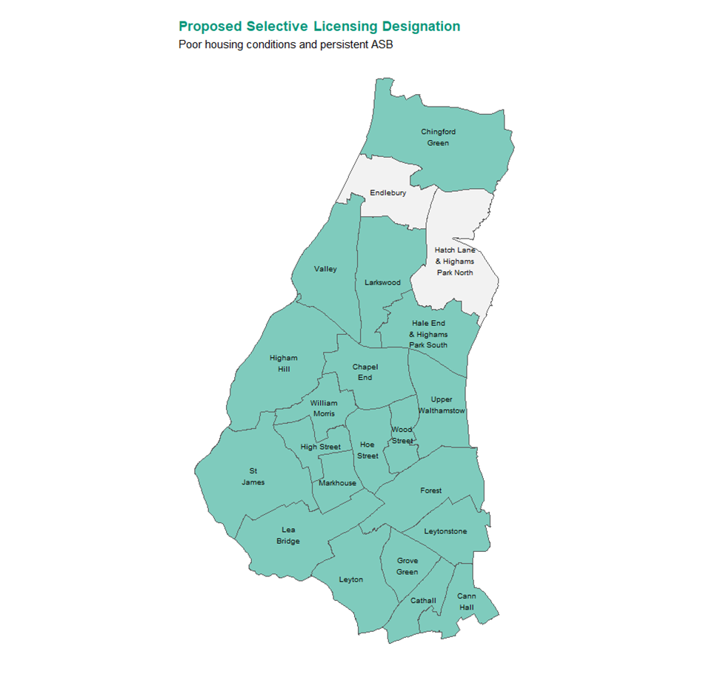
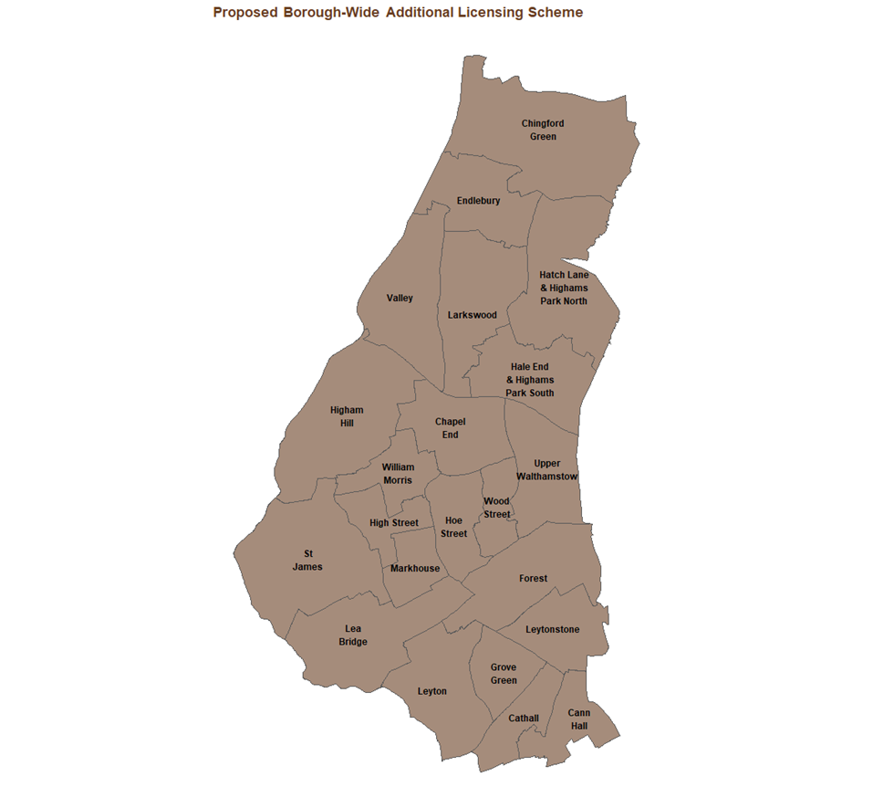
Proposed licensing schemes (Appendix 5)

Slide 14
Proposed licensing schemes – options considered (55/56)
The Council considered a number of other courses of action or alternatives to selective and additional licensing, but do not believe that, individually or collectively, they provide an effective, or as effective a, means of tackling ASB and poor housing conditions in the borough, or of delivering the scale of improvement that we believe is required in the PRS.
These alternatives included:
The use of alternative enforcement powers (Part 1 Housing Act 2004 – HHSRS)
Increased use of prosecutions and/or penalties
Voluntary accreditation
The availability of grant assistance
The use of other ASB powers

Slide 15
Proposed licensing schemes - objectives (58/59)
Objective | Outcome
Improve property conditions and management standards in single family dwellings | Reduce Housing hazards, prioritising those properties containing the most serious hazards and/or those impacted by significant damp & mould
 | Improve licensing compliance rates and property standards by 25% from 2023 baseline
 | Ensure that all licensable properties are licensed in order to better manage, by supervision and licence conditions, ASB and the state of the subject property
Improve property conditions and management standards in HMOs | Ensure that all HMOs are properly regulated, meeting basic safety standards and let in accordance with relevant space/amenity (overcrowding) standards.
 | Improve licensing compliance rates and property standards by 25% from 2023 baseline
 | Ensure that all licensable properties are licensed in order to better manage, by supervision and licence conditions, ASB and the state of the subject property
Landlord engagement | Hold Landlord Forum meetings over the life of the new schemes, and produce E-newsletters to landlord and agent subscribers
Reduce ASB | Reduce repeat ASB incidents in licensed properties by 20% over the life of the scheme

Slide 16
Proposed licensing schemes – Fees, charges and discounts (49/50)
It is proposed that the grant of a licence will be subject to the payment of a fee. The proposed fees for licence applications take account all of the Council’s costs in administering and carrying out its licensing functions to meet scheme objectives.
Licence fees are taken in two parts – the first part is taken on application and covers the cost of processing/determining the application. The second part is payable if the Council is minded to grant a licence.
The proposed selective licence fee is £895 and Additional HMO licence fee £1200.
The Council is proposing to offer certain discounts for landlords that own/control multiple flats within the same building and/or have an EPC of B or better. It is also proposed that certain charities would pay a reduced fee.

Slide 17
Proposed licence conditions (50 & Appendices 2 and 3)
The conditions that the Council proposes to include in licences granted under the selective and additional licensing schemes can be seen in the documents downloadable from the consultation web page.
There are very limited changes from the conditions that are included in licences granted under the Council’s current schemes.
Each set of proposed licence conditions includes, for ease of reference, both ‘mandatory’ conditions that the Council is obliged to include under statute, and local conditions that we propose to include licences granted in Waltham Forest.

Slide 18
Issues raised at the Landlord Forum in January
Subject | Issue | Response/Feedback
Licence renewals | When applying for a new property licence, it would be an easier process if the applicant did not need to re-enter all of the information previously supplied such as details of rooms and their sizes | If an application is submitted whilst a licence is still in force, the applicant can select to renew a licence as opposed to applying for a new one. If an applicant renews a licence, it will not be necessary to provide much of the information that was provided as part of the previous application.
Houses in Multiple Occupation (HMOs) | Why does the Council issue shorter-term licences or refuse applications where an HMO does not have the appropriate planning permission or established use? Are planning considerations a licensing issue? Isn’t this limiting the supply of affordable accommodation including homes where just 3 friends renting on a shared basis? | There has been an Article 4 Direction in place in Waltham Forest since September 2014 that means that permission is needed to change the use from a single-family dwelling to an HMO (whether a ‘C4’ HMO of 3-6 persons and >1 household or larger HMO). The policy aims to resist the further loss of family homes to HMOs/conversions. Caselaw has been established by Waltham Forest that confirms that legitimate to consider planning when deciding a licence application. National definition of what constitutes a single household by reference to prescribed criteria in Housing Act 2004.

Slide 19
Proposed property licensing schemes – responding to the consultation
Friday 15 December 2023 to Sunday 10 March 2024
Read the documents supporting the consultation and complete the on-line survey at:
https://www.walthamforest.gov.uk/consultations/property-licensing-consultation

Slide 20
Proposed property licensing schemes – Next Steps
Once the consultation is complete, the responses will be analysed
The Council’s response to the consultation feedback will be published
The Council will decide whether to designate a new selective and/or additional HMO licensing scheme

Slide 21
Proposed property licensing schemes – Q & A session
Thank you for listening
Please share any immediate questions that you have
https://www.walthamforest.gov.uk/consultations/property-licensing-consultation

