Slide 1
Landlord Forum
London Borough of Waltham Forest
23 January 2024
Microsoft Teams

Slide 2
Welcome & Introductions – Julia Morris, AD Regulatory Services
Introduction to session
Purpose of session
Participants
Structure of session
Housekeeping
This presentation will be loaded onto the Council’s Landlord Forum web page – further information regarding the property licensing consultation can be viewed on the web pages at https://www.walthamforest.gov.uk/consultations/property-licensing-consultation (numbers referenced in red relate to page numbers in the consultation document ‘Improving the Private Rented Sector in Waltham Forest’)

Slide 3
Agenda
Property Licensing Consultation presentation:
Licensing regime overview
Current licensing schemes in Waltham Forest
Criteria relevant to proposed new licensing designations
Proposed new licensing schemes including scope and alternatives considered
Proposed scheme objectives
Proposed licence fee structure including discounts
Proposed licence conditions
Responding to the consultation
Next steps
Q&A session

Slide 4
Property licensing consultation; property licensing overview (14/15)
3 licensing regimes, 1 of which is a mandatory scheme for certain Houses in Multiple Occupation (HMOs)
For all schemes, there are nationally prescribed exemptions
Mandatory HMO licensing – applies to houses, converted flats and some purpose-built flats occupied by > 4 persons forming > 1 h/h who share 1 or more basic amenity (such as a kitchen or W.C)
Additional HMO licensing – other HMOs
Selective Licensing – other rented homes occupied by single family households or by no more than 2 unrelated individuals
All licensable addresses must be licensed in order to legally be let
Granted licences are accompanied by a set of conditions that impose obligations on the Licence Holder

Slide 5
Current property licensing schemes in Waltham Forest (17)
In addition to national mandatory HMO licensing, there are two large-scale discretionary schemes in force:
A borough-wide additional HMO licensing scheme which applies to most HMOs that do not come within the scope of mandatory licensing. This scheme is scheduled to end on 31 March 2025
A selective licensing scheme covering 18 of 20 wards that existed before the subsequent boundary changes. Hatch Lane and Endlebury wards are excluded. This scheme is scheduled to end on 30 April 2025.

Slide 6
Current property licensing schemes in Waltham Forest (2) (18/19)
Performance against scheme objectives
Licence applications and decisions
Performance Metric | Target | Performance
Licence Applications | ~30,000 (5 years) | 26,485
Properties Inspected | 5,600 (3.5 years) | 8,011
Properties Improved | 1,925(3.5 years) | 1,680
 | Applications received | Licence granted full term (5yrs) | Licence granted reduced term* (<5yrs) | Licence refused
Selective | 24,528 | 22,249 | 267 | 855
HMO (Additional and mandatory) | 1,957 | 815 | 578

Slide 7
Current property licensing schemes in Waltham Forest (3) (19/22/23)
Support for landlords and tenants
Other enforcement actions
Post inspection and other warning letters issued | More than 15,000
Service of a legal notice, most frequently under Part 1 Housing Act 2004 (Housing Health and Rating System – HHSRS) such as an Improvement Notice requiring works to be carried out | 223
A criminal prosecution or imposition of a Financial Penalty of up to £30,000 for each offence | 195
The making of an Interim Management Order, whereby the Council assumes management control of a property pending it being licensed | 20
Civil Penalties – Notice of Intention | 233
Successful cases taken in the Upper Tribunal or Court of Appeal to establish caselaw that has set national legal precedents to facilitate more effective enforcement | 7

Slide 8
Private Rented Sector in Waltham Forest – current position (29/40)
Property Condition
It is estimated that over 7,400 private rented properties (27%) have at least one serious category 1 hazard or category 2 damp or excess cold hazard in the proposed designation.
Grove Green (637), St James (626) and Hoe Street (547) have the highest estimated number of properties with serious hazards. Proportionally, Markhouse (37%), St James (33%) and Leyton (33%) have the highest estimated levels of serious hazards.
Anti-social behaviour (ASB)
The PRS has the highest proportion of properties with persistent ASB (23% of PRS properties with persistent ASB) compared with persistent ASB in other tenure types in Waltham Forest (21% of owner occupier properties, 12% of housing association properties and 14% of local authority properties).

Slide 9
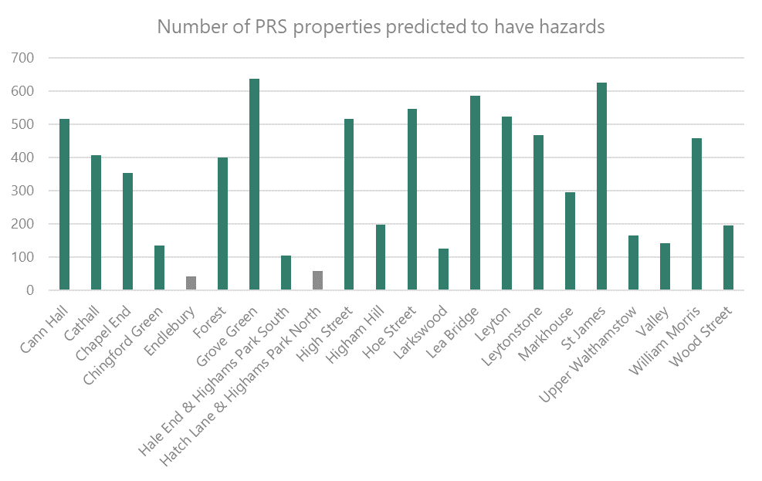
Private Rented Sector in Waltham Forest – property condition (30)

Slide 10
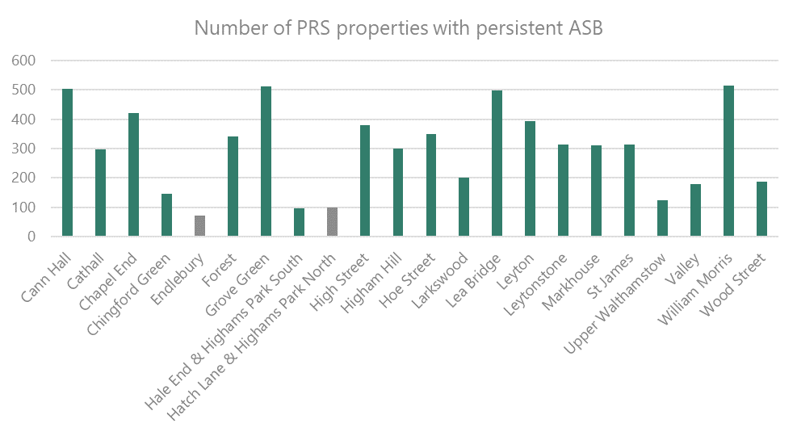
Private Rented Sector in Waltham Forest – ASB (42)

Slide 11
HMOs in Waltham Forest – current position (46/47)
Property Condition
Poor housing conditions are prevalent in Waltham Forest’s HMOs. The evidence shows that nearly one fifth (19%) of HMOs have serious (category 1) hazards, and over half (53%) have category 2 hazards. Converted building HMOs are also usually older houses or buildings converted into flats either under considerably older legal standards, or without any consideration of building standards. Common issues found in all types of HMO are a lack of adequate fire and electrical safety measures, inadequate amenities, overcrowding and damp and mould.
Anti-social behaviour (ASB)
HMOs in Waltham Forest have the highest proportion of properties with repeat ASB compared with other tenure types.

Slide 12
Proposed licensing schemes (25/46)
Selective licensing scheme
A designation covering the 20 of the 22 wards in the Borough in which there is evidenced poor property condition and significant and persistent ASB
The proposed scheme would not include Endlebury and Hatch Lane & Highams Park North wards
Additional HMO licensing scheme
A designation that will apply to all wards in the borough
The proposed scheme, as per the current scheme, would not apply to certain converted flats or blocks (known as section 257 HMOs)

Slide 13
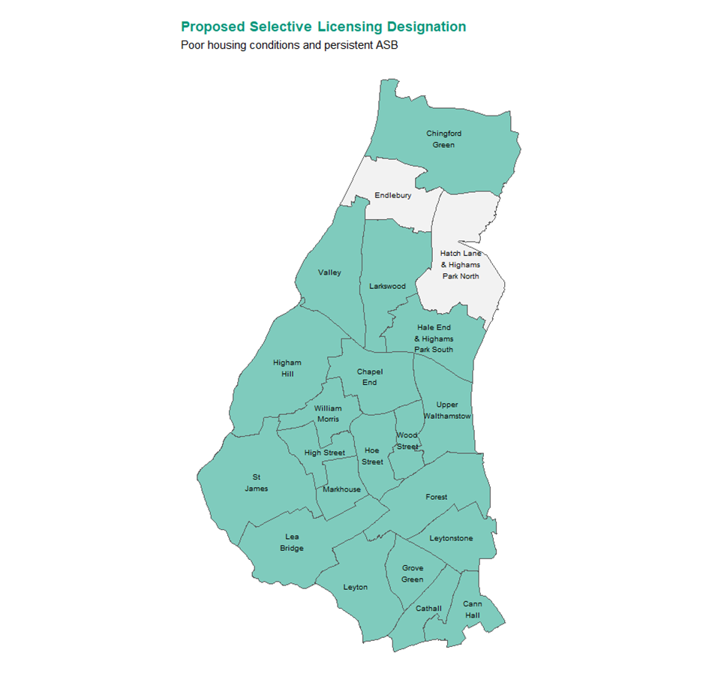
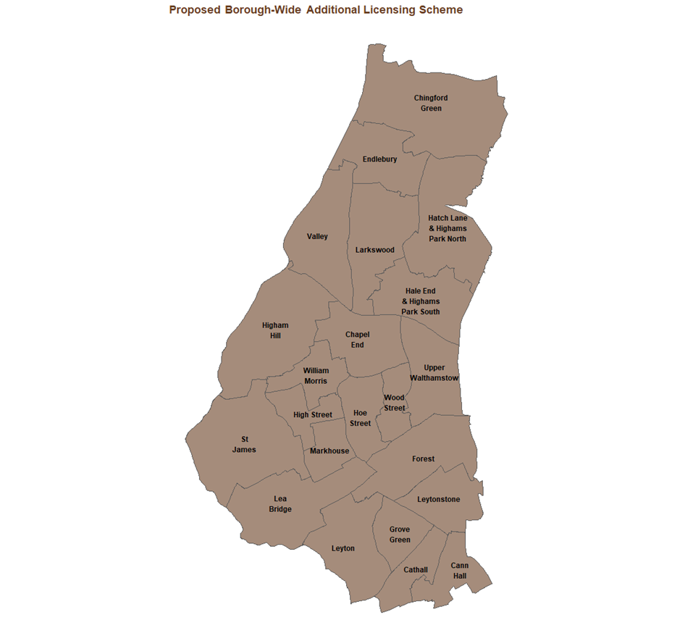
Proposed licensing schemes (Appendix 5)

Slide 14
Proposed licensing schemes – options considered (55/56)
The Council considered a number of other courses of action or alternatives to selective and additional licensing, but do not believe that, individually or collectively, they provide an effective, or as effective a, means of tackling ASB and poor housing conditions in the borough, or of delivering the scale of improvement that we believe is required in the PRS:
Use of Part 1 (HHSRS) powers | No requirement for landlord to proactively maintain property. Provisions bureaucratic and cumbersome, appeals can delay improvements
Increased prosecutions/civil penalties | These powers do not place any obligation on landlords to be proactive in improving conditions. Absence of licensing significantly reduces the scope of the Council to impose civil penalties.
Voluntary accreditation | This requires voluntary landlord engagement and rogue operators are unlikely to attend/engage in such schemes.
Grant assistance | Generally, there are few grants available and the Council has very limited scope to offer grants through successful external funding bids.
ASB powers | The powers do not place any obligations on landlords to be proactive in managing their properties to prevent or reduce the likelihood of ASB occurring.

Slide 15
Proposed licensing schemes - objectives (58/59)
Objective | Outcome
Improve property conditions and management standards in single family dwellings | Reduce Housing hazards, prioritising those properties containing the most serious hazards and/or those impacted by significant damp & mould
 | Improve licensing compliance rates and property standards by 25% from 2023 baseline
 | Ensure that all licensable properties are licensed in order to better manage, by supervision and licence conditions, ASB and the state of the subject property
Improve property conditions and management standards in HMOs | Ensure that all HMOs are properly regulated, meeting basic safety standards and let in accordance with relevant space/amenity (overcrowding) standards.
 | Improve licensing compliance rates and property standards by 25% from 2023 baseline
 | Ensure that all licensable properties are licensed in order to better manage, by supervision and licence conditions, ASB and the state of the subject property
Landlord engagement | Hold Landlord Forum meetings over the life of the new schemes, and produce E-newsletters to landlord and agent subscribers
Reduce ASB | Reduce repeat ASB incidents in licensed properties by 20% over the life of the scheme

Slide 16
Proposed licensing schemes – Fees, charges and discounts (49/50)
It is proposed that the grant of a licence will be subject to the payment of a fee. The proposed fees for licence applications take account all of the Council’s costs in administering and carrying out its licensing functions.
Proposed fees
Proposed discounts
Type of Licence | Part A element (application & processing) | Part B element (enforcement) | Total fee payable [on successful application]
Selective Licence | £300 | £595 | £895
Additional HMO licence | £600 | £600 | £1,200
Nature of discount | Amount
Multi-dwelling discount for or selective and additional licence applications (where multiple properties in the same building are owned and under the control of the same person) | Part A fee reduced by £125 in respect of applications relating to the 2nd, 3rd etc. flat in a block with the Part A fee payable at the full rate for the first flat.
PRS property with an EPC of B or above | Full selective licence fee reduced by £295 and additional by £400 (from Part B payment)
Discount for certain charities (selective licence) | Part B fee reduced to £100

Slide 17
Proposed licensing schemes – fees & discounts - benchmarking (54)
Local Authority | Selective Licence fee (& year scheme commenced) | Additional HMO licence fee | Discounts offered
Barking & Dagenham | £900 (Sept 2019) | NA | A landlord who is considered a fit and proper person, has held a licence with LBBD in the previous scheme and has not been subject to any enforcement or legal action including conviction, caution or civil penalty maybe eligible for a £215 discount
Enfield | £673.80 (Sept 2021) | £1,170 | None
Haringey | £600 (Sept 2022) | N/A | Multi-dwelling discount - £75 on 2nd, 3rd unit etc. Accredited landlord and/or EPC or C or better - £50 discount
Havering | £900 (Jan 2021) | £900 | Accredited landlord - £35 discount. Multi-dwelling discount - £100 on 2nd, 3rd unit etc. *Discounts do not apply where warning letter sent
Newham | £750 (Jun 2023) | £1,250 | Multi-dwelling discount - £50 on 2nd, 3rd unit etc. Accredited landlord and/or EPC or C or better - £50 discount. Discount for new PRS dwellings with EPC of C or better - £350 for selective licence and £450 for additional licence Discount for selective licence addresses used by Newham as nightly paid TA - £350 *Discounts do not apply where warning letter sent
Redbridge | £860 (Nov 2023) | £1,698 - £1,800 | Accredited landlord - £35 discount
Tower Hamlets | £649 (Oct 2021) | £600.50 | None

Slide 18
Proposed licence conditions (50 & Appendices 2 and 3)
The conditions that the Council proposes to include in licences granted under the selective and additional licensing schemes can be seen in the documents downloadable from the consultation web page.
There are very limited changes from the conditions that are included in licences granted under the Council’s current schemes.
Each set of proposed licence conditions includes, for ease of reference, both ‘mandatory’ conditions that the Council is obliged to include under statute, and local conditions that we propose to include licences granted in Waltham Forest.

Slide 19
Proposed property licensing schemes – responding to the consultation
Friday 15 December 2023 to Sunday 10 March 2024
Read the documents supporting the consultation and complete the on-line survey at:
https://www.walthamforest.gov.uk/consultations/property-licensing-consultation

Slide 20
Proposed property licensing schemes – Next Steps
Once the consultation is complete, the responses will be analysed
The Council’s response to the consultation feedback will be published
The Council will decide whether to designate a new selective and/or additional HMO licensing scheme

Slide 21
Proposed property licensing schemes – Q & A session
Thank you for listening
Please share any immediate questions that you have
https://www.walthamforest.gov.uk/consultations/property-licensing-consultation

