Slide 1
Landlord Forum:
Energy Upgrade Loan
26 October 2023

Slide 2
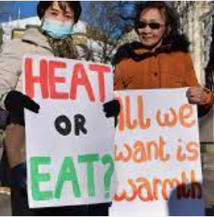
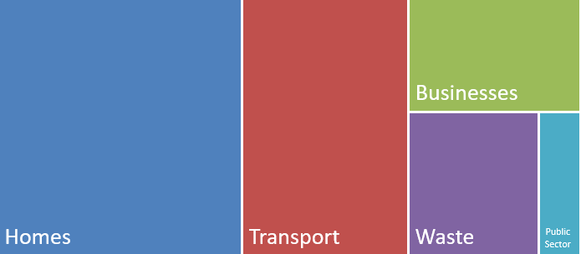
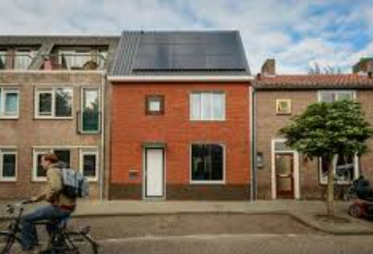
To tackle climate, we need to tackle homes
Our Approach
Improving social housing
Helping homeowners and landlords
42%
Waltham Forest Carbon Emissions (Kt CO2e, DESNZ))
Notes:
Transport 29%, Businesses 13%, Waste 12%, Public Sector 4%.
A simple version is 40/30/20/10 with 20=Business and Public Sector and 10=Waste

Slide 3
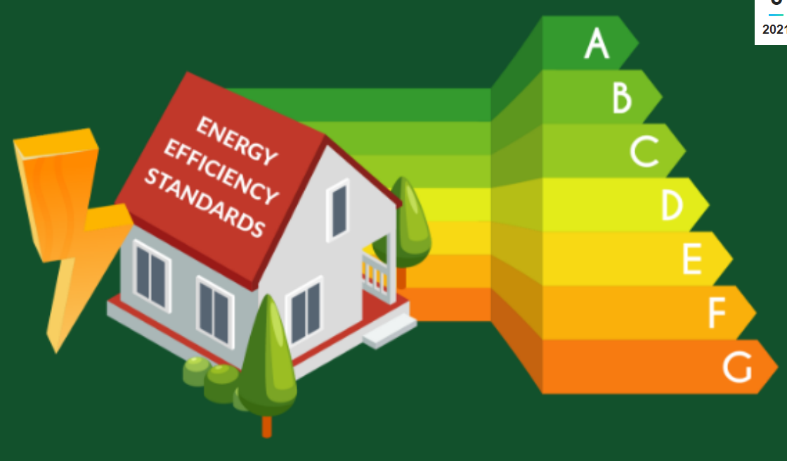
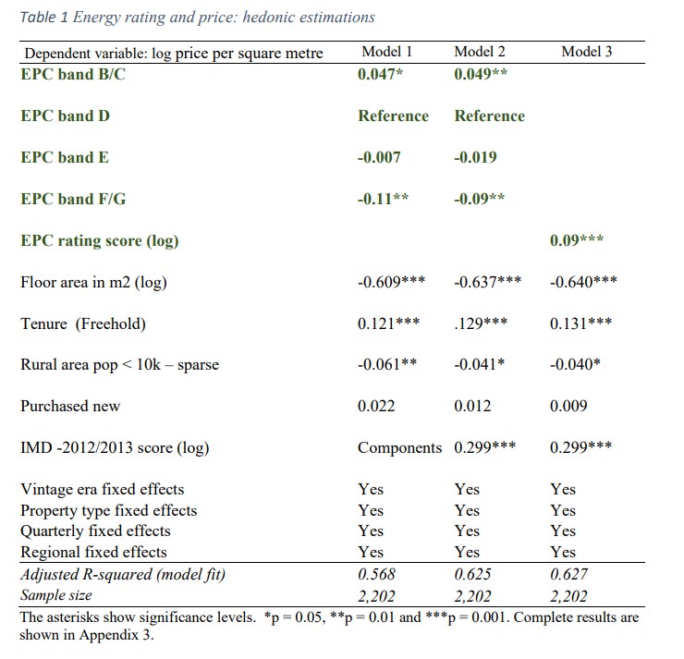
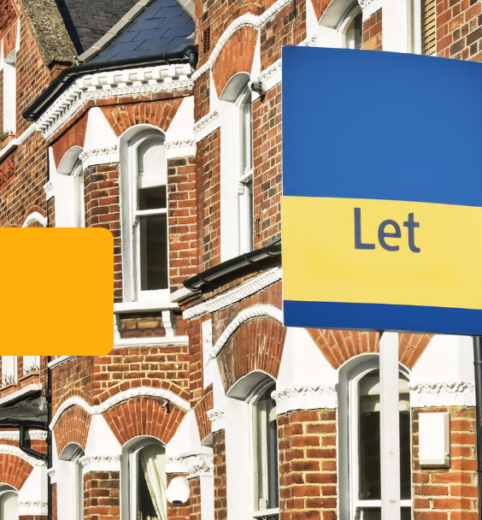
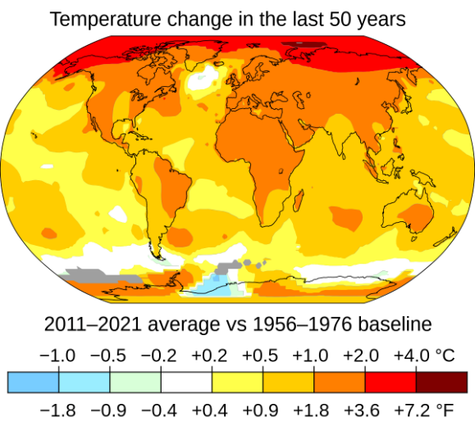
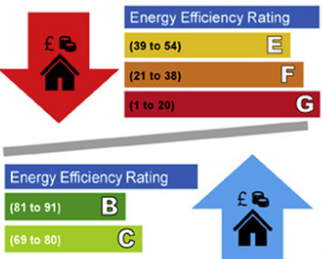
Reasons for upgrading the energy efficiency of homes
££
Notes:
--Improves rent (study shown here) --Helps tackle climate change --MEES - 2018 ‘Minimum Level of Energy Efficiency’ standard (EPC band E)
-- Saves money in longer term

Slide 4
Home types by CO2 emissions
New
Owner-Occupiers
Private Rented
HAs
Council
Private
Council
Other
Key:
Approximate Carbon Emissions

Slide 5
Now…and then slide
Barriers to upgrading the energy efficiency of homes:
“It's not worth it as I don't get the savings”
Now
Expensive, may have money ‘locked’ up in property, may be a landlord and feel you will not recoup cost
Confusing,
Hassle,
No good suppliers,
Vision
Support early adopters
Retrofit Loan…
XX
Trusted advice service
HEWF
Network of past retrofitters
Making the green choice the easy choice
Supportive Planning
Free parking permits
No good suppliers
Retrofit Company
“It’s too expensive”
“It’s too confusing”
“It’s too much hassle”
“It’s too hard to find suppliers I trust”

Slide 6
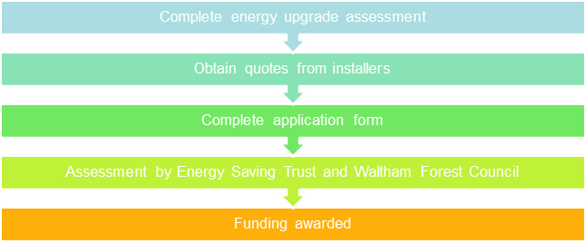
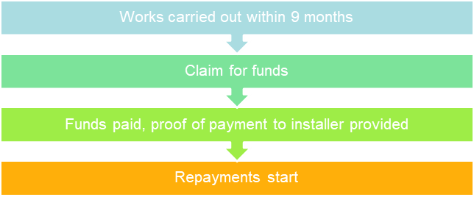
Energy Upgrade Loan – Cost often comes up as the largest barrier. We are launching an Energy Upgrade Loan scheme to support private homeowners and landlords with EPC D or lower.
£2,000 - £20,000
10 years
0 interest
Application Journey
Post Funding Award Journey
Assessment by Energy Saving Trust

Slide 7
Eligible energy efficiency measures:
Energy efficiency: roof and loft insulation, wall insulation, windows and doors, floor insulation, double and triple glazing
Low-carbon heating: air source heat pumps, ground source heat pumps
Solar: Solar PV, solar thermal
Not eligible energy efficiency measures:
Energy storage, such as battery storage
Replacement measures, such as replacement double glazing or heat pumps

Slide 8
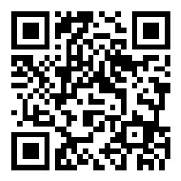
[object File][object File]
What are your thoughts towards the loan?
Join at slido.com with
#3915285
Notes:
https://app.sli.do/event/hnNa18rx4qWbFMVUis88Lb

Slide 9
Landlord Forum:
Winter Energy Support
26 October 2023

Slide 10
What do we have on offer?
Lower Bills, Warmer Homes (DIY collection)
Free energy saving devices for homes to reduce bills
DIY products available for collection e.g. from community spaces, libraries, etc
All households in need eligible
Lower Bills, Warmer Homes (direct delivery)
Free energy saving devices for homes to reduce bills
Direct delivery – installation of products by Service Store targeted to the most vulnerable
Low income households eligible
ECO4 (strict eligibility)
To help eligible households upgrade the energy efficiency of their home for free, saving up to £1800 a year on energy bills
Open to privately owned or rented homes with an EPC rating of D-G, plus on qualifying benefits, household income of less than £31,000, or other listed vulnerability
https://www.walthamforest.gov.uk/get-involved/climate-change/funding-and-support
Energy Saving Tips (anyone)
Find out how you can easily save energy at home
Turn down boiler flow temperature, install draft excluders, move furniture away from radiators, fit LED light bulbs, adding thick curtains or window shutters, etc
Home visits from HEET
Energy Upgrade Loan
Notes:
There is a range of energy efficiency related schemes on offer this winter.
To keep the process simple for residents, a triage form has been developed to help select the best scheme for them, due to complicated eligibility criteria.
There is something on offer for everyone, regardless of their income
Details of the Energy Upgrade Loan will be added once it is live, however this scheme is for the ‘able to pay’ market, who will be in the financial position to receive a low interest loan to make upgrades to their home, such as solar panels, loft insulation, ASHP etc.

Slide 11
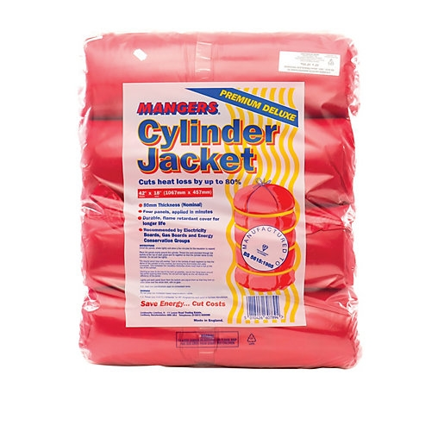
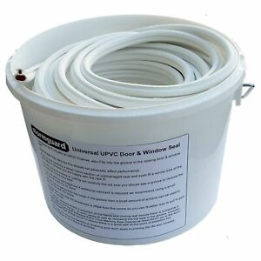
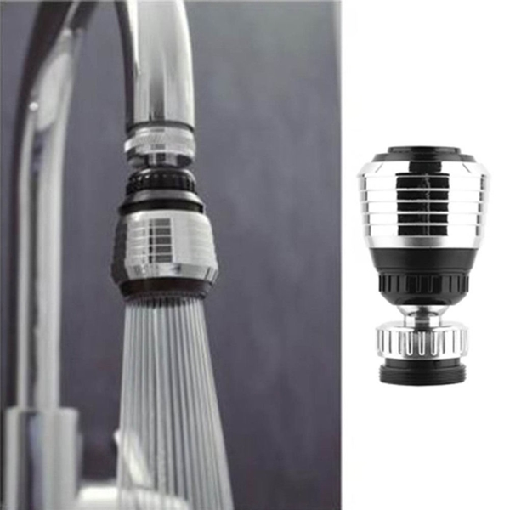
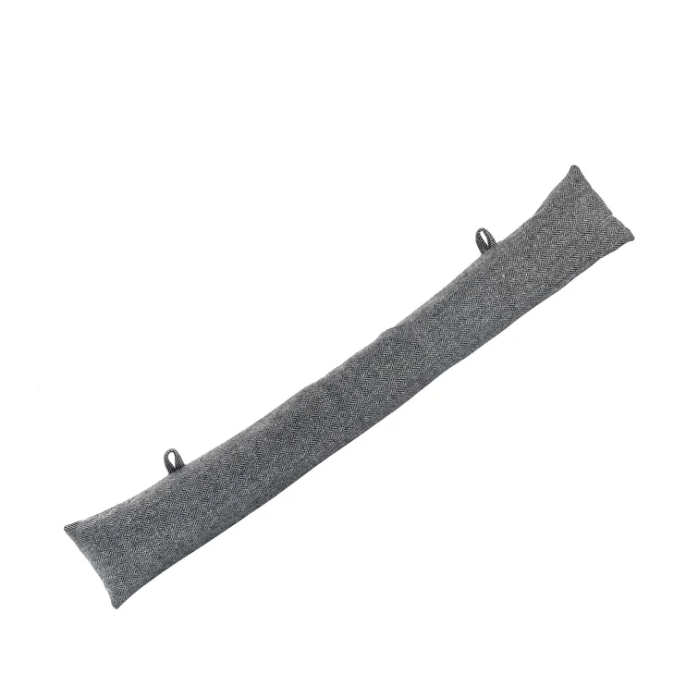
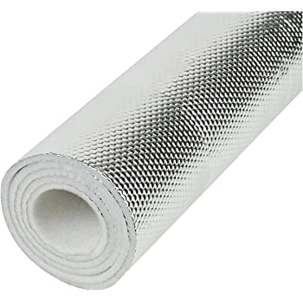
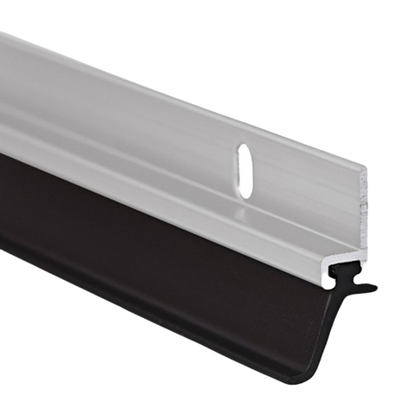
ECO4 measures will be installed on the eligibility of the tenant, with landlord permission
Residents can check their eligibility and sign up here
LBWH measures are either reversible or less invasive
Notes:
The Energy Company Obligation (ECO), is a £1bn government energy efficiency scheme for Great Britain, administered by Ofgem. ECO4 is the 4th round.
ECO obliges energy companies to improve the least energy efficient housing stock occupied by low income and vulnerable households between April 2022– March 2026
ECO4-flex has been set up to allow a participating LA can refer private tenure households that it considers to be living in fuel poverty or on a low income and vulnerable to the effects of living in a cold home. This includes working with health professionals to identify and refer vulnerable residents.
ECO targets those that need it most: low income and vulnerable households living in the least energy efficient housing stock. It is up to the energy companies to determine which projects they fund and installers that they choose to work with.
ECO4 encourages the installation of various energy efficient measures such as insulation measures, renewable heating, first time central heating and district heating connections.
We have partnered with 3 energy companies and split the borough geographically to bring as much funding into the borough as possible
These are trusted partners and we are monitoring their customer service and
ONLY AVAILABLE TO HOMEOWNERS OR PRIVATE RENTERS

