Slide 1
Private Sector Housing & Licensing Landlord Forum
5th July 2023

Slide 2
Agenda
Licensing update
Luke Ravenscroft – energy efficiency
Chris Mattingley – LFB, charge safe campaign
Richard Blanco – NRLA
There will be time for a Q & A after each presentation. Please wait until the end of the presentation before raising your hand. Any questions should be general and not specific to your individual application/property

Slide 3
Housekeeping
Please ensure Microphones and Cameras are off, until asking a question.
You can ask a question by typing it in the comments and a colleague will respond.
At the end of each presentation there will be a chance to ask questions if you could raise your hand.

Slide 4
Core functions & changing demands
The PSH&L service is an accumulation of several functions, predominantly relating to the regulation of conditions and management practices in the private rented sector. It has a significant focus on the administration and enforcement of property licensing schemes but officers in the service perform other key functions.
Core functions
PSH & L
Licensing applications, fee collection, & issuing
HMOs
Multi-agency Tasking Days
RP Enforcement
Cladding Enforcement - PRS
Proactive and reactive Inspections
Enforcement – formal notices, prosecutions, civil penalties, IMOs/FMOs etc
Asylum seeker accommodation
Non-licensed accommodation e.g. ‘Beds in Sheds’
Empty Residential Properties
Cold Homes
ASB in PRS homes e.g. Noise
Harassment & Illegal Eviction (partner org)
Owner Occupied homes – self-neglect, enforcement
Landlord Forums & tenant drop in sessions
Service has continued to adapt to meet changing needs and priorities, whilst meeting core licensing scheme objectives. In past 12-18 months, this has included:
Establishment of a Team to prioritise action against empty homes and/or homes with poorest energy efficiency
Responding to additional service demands following November 2022 inquest that concluded damp and mould caused death of 2-year old Awab Ishak
Establishment of weekly tenant-drop in sessions
Inspections of accommodation offered by sponsors under the ‘Homes for Ukraine’ scheme
Participation in the ‘Safe Streets’ pilot
‘Healthier homes for private renters’ identified as one of the four key Marmot accelerators and service will continue to adapt to meet new challenges and opportunities

Slide 5
Property Licensing
Current licensing schemes
Selective Licensing – regulatory framework & resources
3 licensing schemes currently in force:
Borough-wide Mandatory HMO licensing – applies to most larger HMOs
Borough-wide Additional (HMO) licensing – came into force on 1 April 2020 and applies to smaller HMOs and some larger HMOs
Large-scale Selective licensing – came into force on 1 May 2020 and applies to SFDs or homes occupied by no more than 2 unrelated adults in all wards except Hatch Lane & Endlebury
Licence conditions – require proactive approach to property maintenance and management
Golden triangle of licensing objectives, staffing resources and licensing fees:
How is licensing to be used to tackle issues that justified designation?
What staffing and other resources is required to deliver?
What does the licence fee need to be to deliver cost-neutral scheme?
Current designations – scheme objectives
Property Licensing in Waltham Forest
Authority satisfied that criteria for designating large scale selective and additional licensing schemes met – SL scheme on grounds of property condition and ASB
Authority required to set out scheme objectives to tackle identified grounds for designating schemes
Identified scheme objectives include
Ensuring that all licensable addresses are licensed (now estimated ~30k of which ~2k HMOs)
Carrying out audit checks including ~8k physical inspections
Improving ~550 properties each year, including 100 HMOs
Has enabled us to:
Tackle rogue operators and create a level playing field for responsible landlords and agents
Carry a proactive inspection and enforcement capability
Use licensing and other data to carry out intelligence-led audits
Employ a full range of enforcement options to bring about improvements in property conditions
Flex resources to meet new demands

Slide 6
Performance & Outputs
Other selected data/performance metrics
Description | Performance
Licence applications determined | 23408
Licences Revoked, varied, refused or granted for a reduced term | 1849
Service Requests | >800 per annum
Enforcement action – warning letters (includes post-inspection, unlicensed address) | >12000
Enforcement action – formal notices | 212
Enforcement action – Civil (financial) penalties (CPs) and prosecutions – 2022/23 | 88 Notice of Intent CPs and 69 Final CPs issued. 11 prosecutions
Enforcement action – Interim Management Orders/Final Management Orders | 20
Enforcement action – Cold and Empty Homes – 2022/23 | 23 long-term void homes brought back into use 28 worst performing homes (EPC F or G EPC rating) improved
Core licensing scheme objectives
Performance Metric | Target | Performance
Licence applications | ~30000 (5 year) | 24918
Properties inspected | 4800 (3 year) | 5668
Properties improved | 1650 (3 year) | 1504

Slide 7
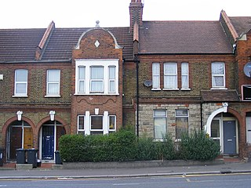
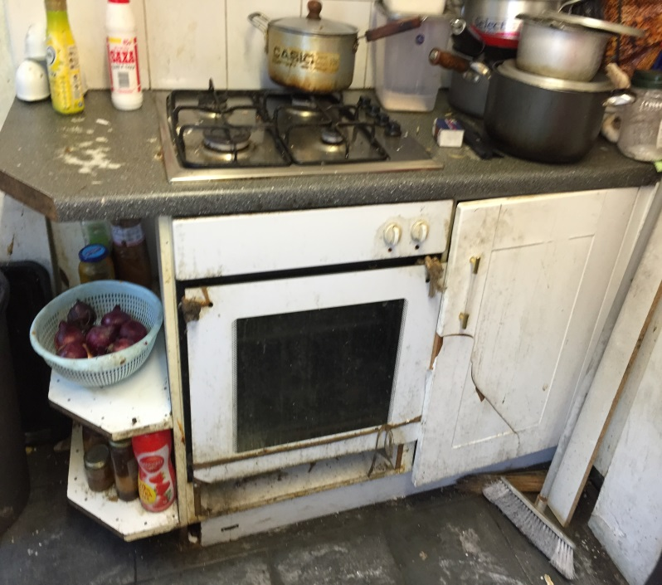
Private Sector Housing & Licensing service ‘highlights’
1
Regional and National profile in successfully intervening to improve property conditions. >4500 homes improved through successive selective licensing scheme
2
Working across services and with external partners to deliver on key Council priorities
3
Regular ‘Action Days’ of concentrated enforcement activity in an area or by portfolio landlord
4
National leaders in use of Interim Management Orders to take over management of unlicensed properties with Lettings Waltham Forest managing homes
5
Creating National case law – pushing the boundaries to test the law, intervening to enhance outcomes for our residents

Slide 8
Renters Reform Bill
Guide to the Renters (Reform) Bill - GOV.UK (www.gov.uk)
Tenancy reform: Renters (Reform) Bill - GOV.UK (www.gov.uk)
Private Rented Sector Ombudsman: Renters (Reform) Bill - GOV.UK (www.gov.uk)
Privately Rented Property Portal: Renters (Reform) Bill - GOV.UK (www.gov.uk)
Renting with pets: Renters (Reform) Bill - GOV.UK (www.gov.uk)

Slide 9
Future updates
All Presentations given tonight will be available on the website within the next few days.
The website will be updated regularly over the next few months – it is advisable to check the website for any updates.
Newsletters will be sent out with any significant updates.
We want your ideas for next Landlord Forums – topics to be discussed.

Slide 10
Contact us
https://www.walthamforest.gov.uk/content/property-licensing
Propertylicensing@walthamforest.gov.uk
020 8496 4949

