Slide 1
Private Sector Housing & Licensing Landlord Forum
Julia Morris
6 October 2022

Slide 2
Agenda
Licensing update – Climate Emergency/Cost of living crisis.
Richard Blanco NRLA – legislation/tax changes
Ben Reeve-Lewis – Fire Regs/Decent Homes standard
Marta Wasinska - ASB
There will be time for a Q & A after each presentation. Please wait until the end of the presentation before raising your hand. Any questions should be general and not specific to your individual application/property

Slide 3
Housekeeping
Please ensure Microphones and Cameras are off, until asking a question.
You can ask a question by typing it in the comments and a colleague will respond.
At the end of each presentation there will be a chance to ask questions if you could raise your hand.
This meeting will be recorded.

Slide 4
Climate Action and energy efficiency
Waltham Forest about to publish its Climate Action Plan
We know that ~50% carbon emissions in Waltham Forest come from existing homes
Waltham Forest properties much older and less energy efficient than national profile
Significant priority in action plan will be to upgrade/insulate homes
Fuel & cost of living crisis has given greater focus to this issue
Our immediate asks of landlords & agents
Review the energy efficiency of rental properties against MEES and HHSRS. Identify necessary improvements
Support tenants who request permission to carry out improvements
We will
Write to all landlords/agents who subscribe to the property licensing mailing service with further information regarding improvement options

Slide 5
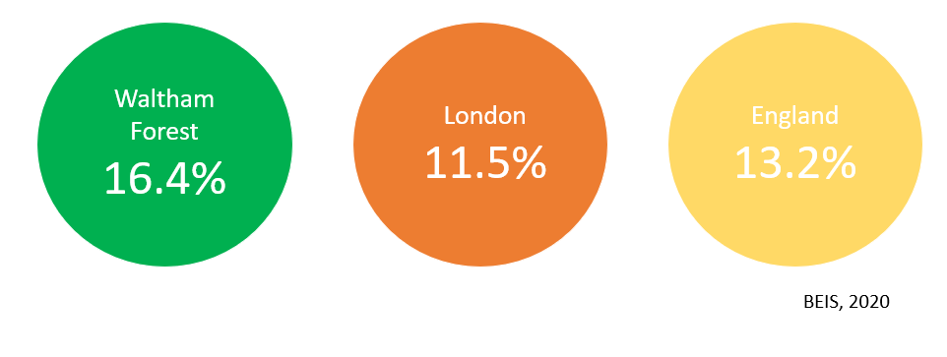
Climate Action and energy efficiency
Fuel Poverty in Waltham Forest
Waltham Forest generally has higher level of fuel poverty – due in part to the high level of older properties in the borough which are less energy efficient so more expensive to heat.
In some areas of the borough, fuel poverty is as high as 27%

Slide 6
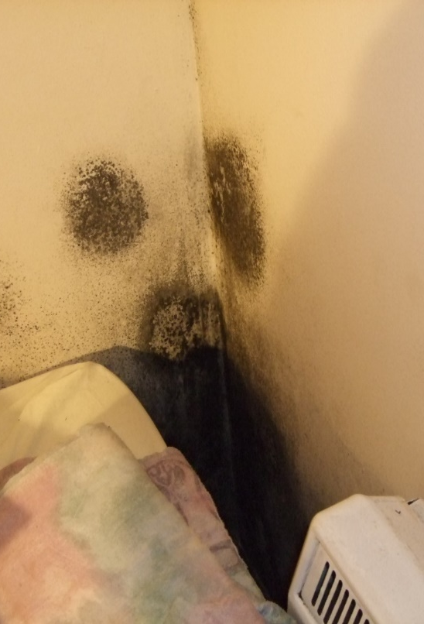
Climate Action and energy efficiency
How does this affect you as a landlord?.
Residents struggling with rent costs, council tax, food and energy bills
Risk of eviction if bills not paid
‘Self'-disconnection for prepayment customers - implications for the property
Business' folding leading to job cuts – none payment of rent
Landlord of HMO’s directly affected with increased fuel costs.
If not heated sufficiently can lead to condensation and mould
8% of households living in relative poverty have a severe condensation problem

Slide 7
Climate Action and energy efficiency
Support that is available from the government.
Government has announced an energy price freeze for 2 years
£400 one-off bill discount for everyone spread over 6 months
£650 payment for 8 million households on means tested benefits
£300 payment for over 8 million pensioner households paid alongside the Winter Fuel Payment
£150 payment for around six million people across the UK who receive certain disability benefits

Slide 8
Climate Action and energy efficiency
The Mayor of London’s Warmer Homes Grant:
Since April 2020, landlords can no longer let or continue to let properties covered by the MEES Regulations if they have an EPC rating below E, unless they have a valid exemption in place.
This requirement is due to increase to a minimum of EPC Band C by 2030.
If your tenant is on a means-tested benefit or a residual income of under £20k, you may be eligible for a grant of up to £25,000 to improve your property’s energy efficiency.
Visit www.london.gov.uk/warmerhomes for eligibility and to apply.

Slide 9
Climate Action and energy efficiency
Other support that is available – Shine London
A free energy and bills advice service for London
Operated by Islington Council and funded be EDF, GLA, Local Authority Contracts
Principle aims are to tackle fuel poverty

Slide 10
Climate Action and energy efficiency
Other support that is available – Shine London
Target Group
Low Income and spending over 10% on energy
Older people (60+)
Long term health issues (respiratory or cardiovascular conditions)
Families with children under 16.

Slide 11
Climate Action and energy efficiency
Other support that is available – Shine London
Help offered
Telephone support for Energy and bills advice
Electricity and water discounts
Energy supplier comparisons – advice at present not to change
Priority Service registration
Last year applied for £136,000 of grants for clients

Slide 12
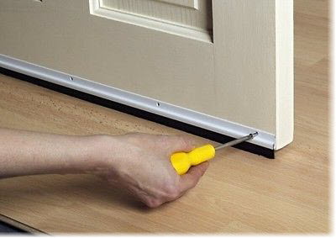
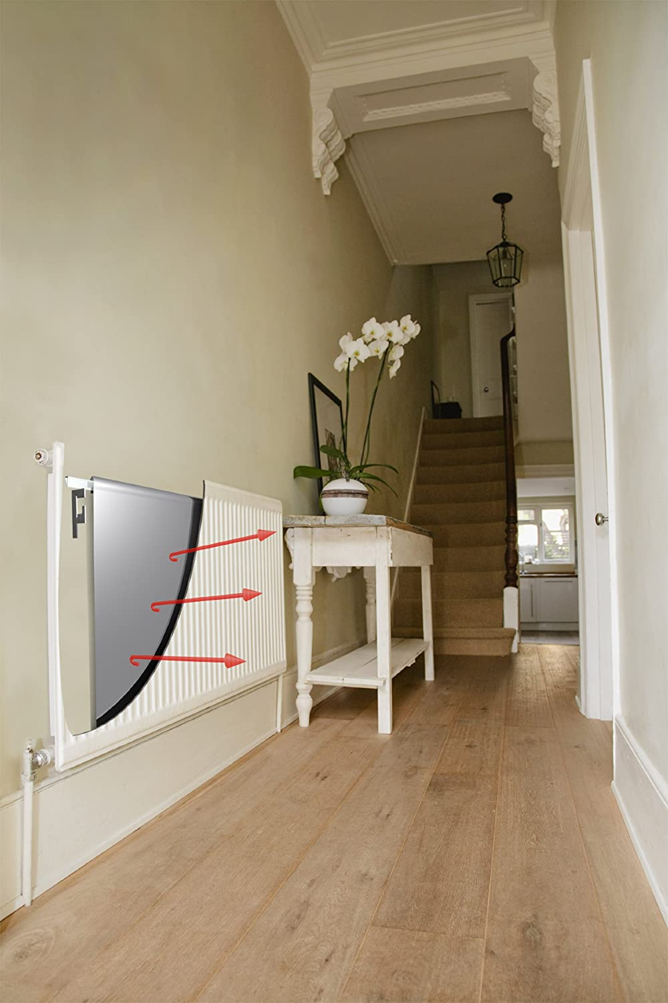
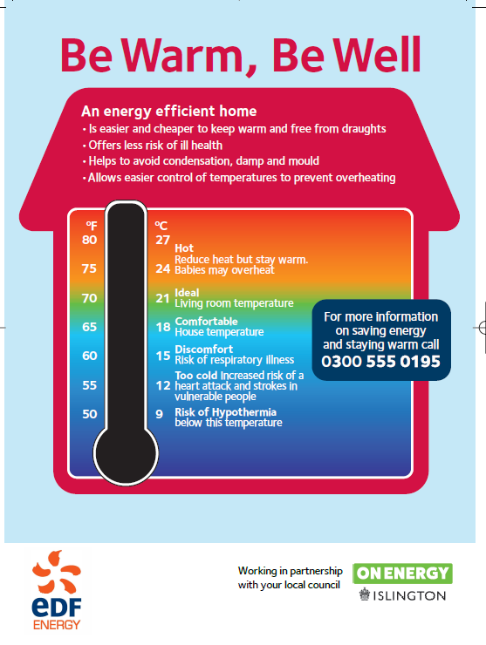
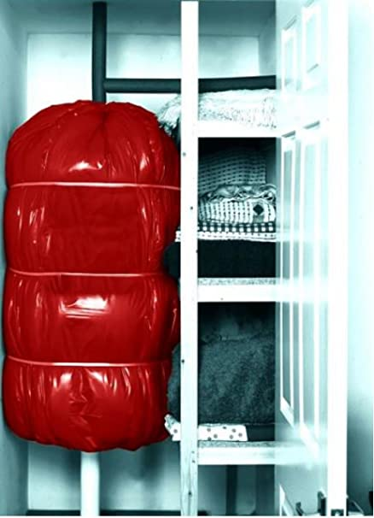
Climate Action and energy efficiency
Other support that is available – Shine London
Energy Doctor – Home visits
Install energy saving measures
Review bills
Mediation with Suppliers
Heating controls check
Identify grant eligibility
Last year energy doctors service saved clients £86,000 and 853 tonnes of CO2

Slide 13
Climate Action and energy efficiency
Other support that is available – Shine London
Contact details
Direct Dial: 0207 527 6178
Email: Terence.Jeffery@islington.gov.uk
Twitter: @shine_network

Slide 14
Climate Action and energy efficiency
Other support that is available – HEET
Taking referrals by phone and email
Phone call to the resident to discuss their situation, give advice over the phone and arrange a home visit
Home visit to carry out a survey, identifying possible energy efficiency improvements and advising on energy saving behaviours
Installing small measures such as draught proofing
Referring for funding for larger measures including insulation and heating measures

Slide 15
Climate Action and energy efficiency
Other support that is available – HEET Eligibility for support
Someone in the household is over 60
Someone in the household has a long term illness or disability
In receipt of income related or disability benefits or household income below the Minimum Income Standard

Slide 16
Climate Action and energy efficiency
Other support that is available – HEET Measures
Small measures
Draught proofing
LED lighting
Radiator panels
Large measures
Wall insulation
Loft insulation
Floor insulation
New heating
Heating repairs

Slide 17
Climate Action and energy efficiency
Other support that is available – HEET
info@theheetproject.org.uk 020 8520 1900 www.theheetproject.org.uk

Slide 18
Climate Action and energy efficiency
Other support available
7 September – Mayor announces emergency energy advice service for Londoners.
Website and dedicated phone line
Advice on how to manage bills and to make homes more energy efficient
Will be open to anyone in London
Will be open from November 2022

Slide 19
Climate Action and energy efficiency
Other support available – Healthy start
Women more than 10 weeks pregnant or families with a child under 4, the Healthy Start scheme can help:
Those eligible will be sent a Healthy Start card with money on it that can be used in some UK shops. This card will be topped up every 4 weeks.
The card can be used to buy:
plain liquid cow’s milk
fresh, frozen, and tinned fruit and vegetables
fresh, dried, and tinned pulses
infant formula milk based on cow’s milk

Slide 20
Climate Action and energy efficiency
Other support available – Healthy start
The card can also be used to collect:
Healthy Start vitamins: these support you during pregnancy and breastfeeding
vitamin drops for babies and young children: these are suitable from birth to 4 years old

Slide 21
Climate Action and energy efficiency
Other support available – Healthy start
To claim the Healthy start card:
If on Universal credit, can apply online if:
at least 10 weeks pregnant or have at least one child under 4 years old
family’s monthly ‘take-home pay for this period’ is £408 or less from employment
https://www.healthystart.nhs.uk/how-to-apply/

Slide 22
Future updates
All Presentations given tonight will be available on the website within the next few days.
The website will be updated regularly over the next few months – it is advisable to check the website for any updates.
Newsletters will be sent out with any significant updates.
We want your ideas for next Landlord Forums – topics to be discussed.

Slide 23
Information available for landlords
Regular information sharing via newsletter
Regular landlord forum with speakers on a variety of topics
Access to Landlord guide, available on the website
https://www.walthamforest.gov.uk/guidance-landlords-and-tenants/guidance-landlords
.

Slide 24
Contact us
https://www.walthamforest.gov.uk/content/property-licensing
Propertylicensing@walthamforest.gov.uk
020 8496 4949

