Slide 1
Private Sector Housing & Licensing Landlord Forum
Julia Morris
Date: 27th April 2022

Slide 2
Housekeeping
Please put yourself on mute when not speaking. This will avoid background noise and feedback.
All cameras should be off unless presenting.
The meeting is being recorded. The recording may be made available online.
If you wish to ask a question in person please use the ‘raise hand’ function. (This is on the right of the tool bar in the centre of your screen). The Chair will then call on you to unmute, switch on your camera and ask your question in person.
If you wish to ask a question without using your microphone please use the ‘chat’ function. (This is on the far right of the tool bar in the centre of your screen). You can type your question there, please note all participants will be able to see the question.

Slide 3
Agenda
Licensing update
Rhiannon Haycock, GLA – Warmer Homes
Yasmin Hussain, LBWF – Accommodation procurement
Evelyn Williams, LBWF – Empty Properties
Jonathan Joseph, LBWF (covered by JM) – Landlord incentives
There will be time for a Q & A after each presentation. Please wait until the end of the presentation before raising your hand. Any questions should be general and not specific to your individual application/property

Slide 4
Update on licensing
Applications Received/issued to date
Selective Applications – 20591/16278
Additional HMO – 1104/557
Mandatory HMO – 607/282
Whilst we have applications outstanding we are working hard to determine licences.
All HMO’s are required to be inspected prior to the licence being issued.
You can help us by ensuring all applications are complete with correct information and the gas certificate is provided.

Slide 5
Information available for landlords
Regular information sharing via newsletter
Regular landlord forum with speakers on a variety of topics
Access to Landlord guide, available on the website
https://www.walthamforest.gov.uk/guidance-landlords-and-tenants/guidance-landlords
Reduced pest control fees
.

Slide 6
Eco Show Home
Fully retrofitted home in E17 available to view by everyone.
Lots of ideas for options available.
15% of visitors to the home have been Private Landlords.
Several guided tours are being set up for landlords to attend.
An invite will be sent out shortly for several dates and tours will be
every hour.
The tour will cover key improvements installed, including costs.
There will also be an overview of the MEES changes and financial
Support available.
If interested please contact housingstrategy@walthamforest.gov.uk.
https://www.walthamforest.gov.uk/planning-and-building-control/design-and-conservation/eco-home-47-greenleaf-road

Slide 7
Enforcement
Whilst we always strive to work with landlords to improve
property standards and reduce ASB, sometimes Enforcement
action is required.
The following options are available to us
Prosecution
Financial Penalty
Notices
Interim Management Orders
Financial Management Orders

Slide 8
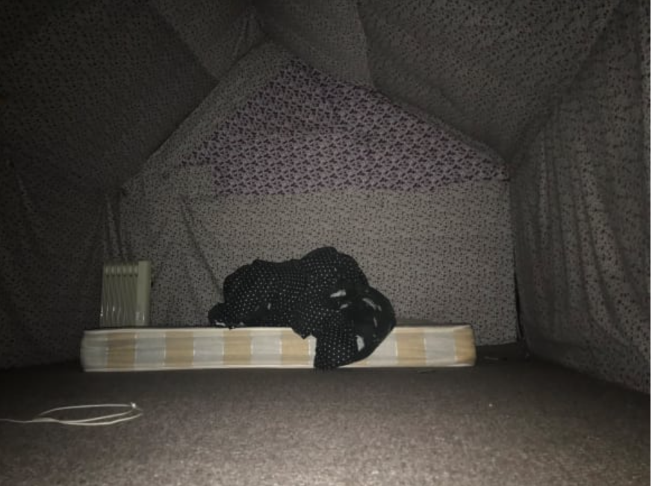
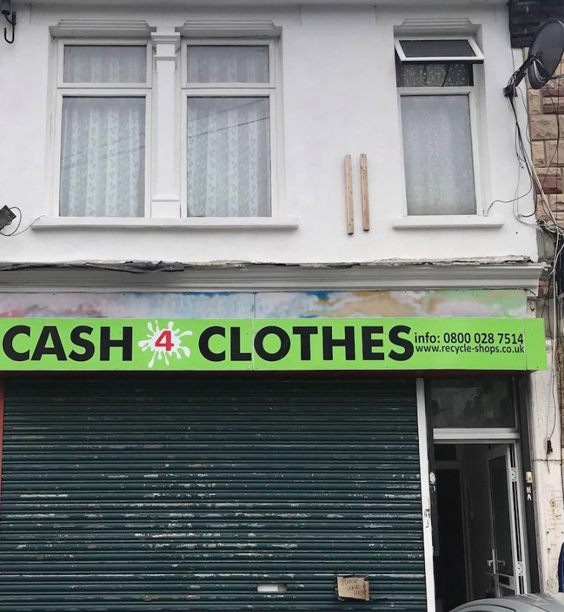
Enforcement
Mr A rented out two flats at the address, one of these was behind the shop front. The other was the first and second floor as a HMO with the loft as demonstrated in the picture.
Both unlicensed and infested with rodents

Slide 9
Enforcement
First visit to the premises in June 2019, Mr A was harassing the tenants and had arranged to have the gas meter removed.
30 faults were found in the property, including defective smoke alarms and multiple leaks.
Prohibition order was served on the ground floor.
IMO made for the first floor flat to ensure tenants protected.
Mr A charged with seven offences including failure to licence.
On 9 Dec 2021 case was heard in Mr A absence, found guilty of all charges, Judge William Nelson called the defendant “duplicitous” and he “deceived multiple tenants” he also commented that the premises being in “atrocious condition”.
One of the previous tenants also gave evidence in court.
Mr A was fined £45k and ordered to pay costs

Slide 10
Future updates
All Presentations given tonight will be available on the website within the next few days.
The website will be updated regularly over the next few months – it is advisable to check the website for any updates.
Newsletters will be sent out with any significant updates.
We want your ideas for next Landlord Forums – topics to be discussed.

Slide 11
Contact us
https://www.walthamforest.gov.uk/content/property-licensing
Propertylicensing@walthamforest.gov.uk
020 8496 4949

