Slide 1
Home Energy Efficiency Training
Our Mission Is To
“Work with the community to make the homes of local people safe and healthy with affordable fuel bills and low carbon emissions”

Slide 2
Landlord’s Responsibilities with regards to Heating, Energy Efficiency & Fuel
Provide tenant with an Energy Performance Certificate (EPC), showing that the property meets the Minimum Energy Efficiency Standards (MEES) i.e. property has a rating of E or above.
Provide tenants with a reliable source of heating and hot water. The heating must be able to provide temperatures of 18°C in sleeping rooms and 21°C in living rooms when the temperature outside is 1°C.
Keep appliances for heating and hot water safe and in good repair - including an annual safety check on gas appliances. It is illegal to make tenants responsible for the heating and hot water systems.
Allow tenant to make energy efficiency improvements to their home where there is no cost to them (i.e. if you are able to access a grant or want to pay for it yourself).
Allow tenant to choose their energy supplier if they pay the bills and have their own metered account.
If energy bills are covered in the rent and paid by you, the Landlord cannot charge more than the maximum resale price for the energy used. Landlord’s must be able to demonstrate how they have calculated the amount they charge for energy.

Slide 3
Funding for Heating and Energy Efficiency
Energy Company Obligation
Warm Homes Fund
Green Homes Grant

Slide 4
Application is in tenant’s name
Eligibility
Tenant must be either:
In receipt of an income related or disability benefit OR
Be fuel-poor (low-income and high fuel costs)
Property must
Meet MEES Standards – except for renewable heating and Solid Wall Insulation
Measures Available
First time central heating including renewable heating ✔
Storage heaters ✔
Loft and wall insulation✔
Replacement gas boiler ✘
Gas boiler repair ✘
Measures are rarely fully funded. Grant amount depends on carbon saved

Slide 5
Warm Homes Fund
Who is it for?
Waltham Forest residents living in homes without central heating (electric heaters, storage heaters, gas or coal fires).
Tenant must be low-income or have a long-term health condition
What is on offer?
Free gas connection if there isn’t one and installation of gas central heating system.
Renewable heating system – most likely air source heat pump
Advantages
Gas central heating is typically three times cheaper than electric heaters (running cost of air source heat pump is slightly higher).
Tenant more able to afford warmth. Fewer complaints
If home is warm condensation is less likely to be a problem

Slide 6
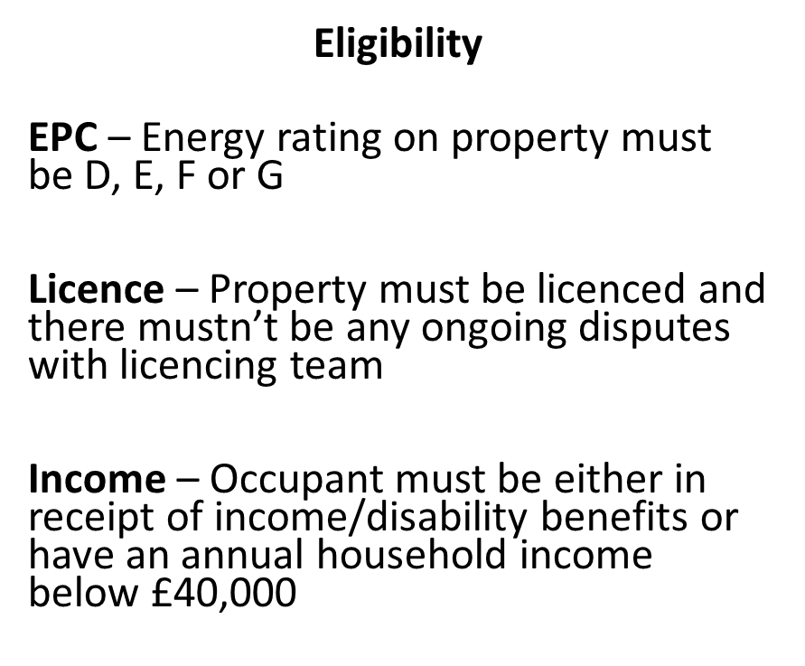
Green Homes Grants
Local Authority Scheme
Scheme managed by Local Authority (Service Store)
Surveys carried out by HEET
Eligibility criteria applies
Support given to tenant and landlord to find installer and have measures fitted.

Slide 7
Green Homes Grant Grants of up to £5,000 are available to landlords. Landlord has to contribute 1/3rd towards cost of works
Primary Measures
Insulation measures – loft, wall, flat roof, underfloor insulation.
Renewable heating - Heat pump solar thermal or biomass boiler
Secondary Measures
Windows & doors – draught proofing, upgrading single glazed windows
Heating controls – appliance thermostats, smart controls, zone controls

Slide 8
Contact
Tom Ruxton – Co-Ordinator
referrals@theheetproject.org.uk
020 8520 1900
www.theheetproject.org.uk
c/o Trinity URC, 58 Orford Road, London E17 9QL
Email through website:
https://walthamforestservicestore.co.uk/contact-us/
Or Phone: 020 8496 5525

