Slide 1
Home Energy Efficiency Training
Our mission is to
“Work with the community to make the homes of local people safe and healthy with affordable fuel bills and low carbon emissions”
Tel 020 8520 1900
info@theheetproject.org.uk
Notes:
We are working in partnership with a variety of council departments the NHS and social services to help improve peoples lives by helping them to have access to affordable warmth.

Slide 2
Fuel Poverty in Waltham Forest
Third highest level of fuel poverty of all London boroughs (14.6%) totaling an estimated 14,562 households
Cabinet has approved the council’s new fuel poverty strategy which sets out how the council plans to tackle fuel poverty over the next 5 years
This includes improving domestic energy efficiency and proactively identifying those in fuel poverty or at risk of ill-health due to a cold home
Notes:
A household is said to be in fuel poverty when its members cannot afford to keep adequately warm at a reasonable cost, given their income. One of the reasons for the high level of fuel poverty in our borough in comparison to other London boroughs is likely to be the age of our homes. 60% of Waltham Forest’s private sector homes were built pre-1919, in comparison with only 25% of England’s private sector homes.
As well as the age of our stock, a contributing factor to fuel poverty in the borough is the lower median weekly earnings of Waltham Forest residents, in comparison to other boroughs. At £529.20, Waltham Forest has the 7th lowest median weekly earnings of all London boroughs (ONS, 2017).

Slide 3
Damp & Condensation
3% of English homes (604,000 homes) have a severe condensation problem
8% of households living in relative poverty have a severe condensation problem
15% in private rented
9% in social rented
An energy efficient and well-ventilated home can help prevent damp and mould.
Notes:
This is what fuel poverty can lead to. Damp and mould. When a house is not adequately heated (and or ventilated) warm/er air finds cold spots and this can lead to condensation and mould.

Slide 4
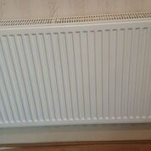
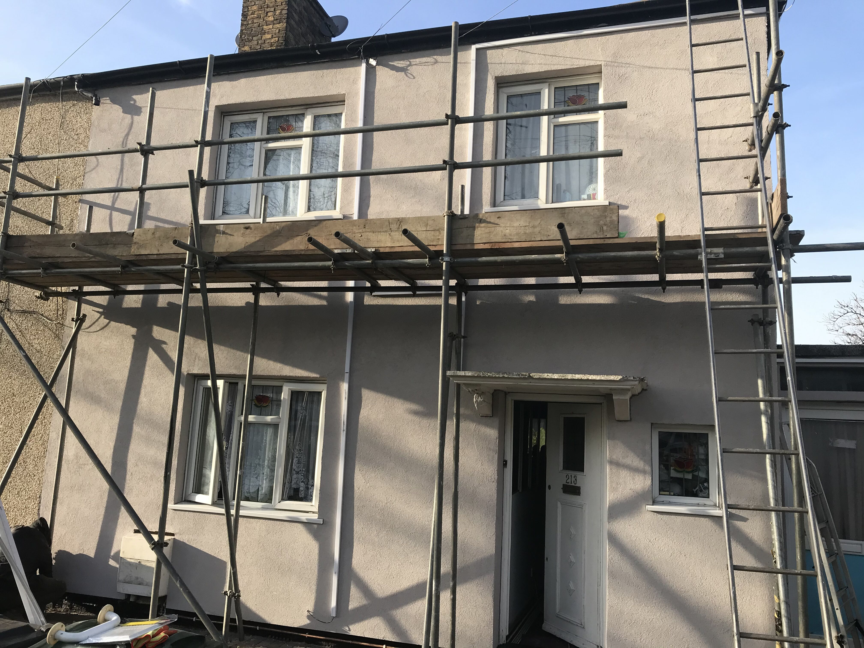
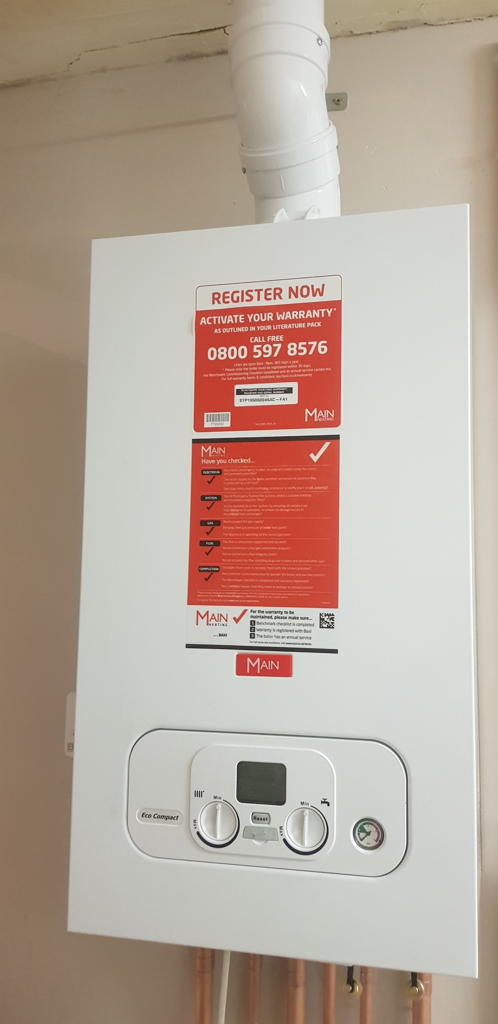
HEET CAN HELP TO FUND
GAS CONNECTIONS AND FIRST TIME CENTRAL HEATING
FLOOR AND WALL INSULATION
BOILER REPLACEMENT
LOFT INSULATION AND DRAUGHT PROOFING
ENERGY ADVICE, TARIFF SWITCHING, WARM HOME DISCOUNT AND INCOME MAXIMISATION FOR TENANTS

Slide 5
GRANTS/SUPPORT AVAILABLE VIA HEET Contact HEET 020 8520 1900 info@theheetproject.org.uk
The Warm Homes Fund
Provides funding for a gas connection and a first time central heating system to residents who meet certain qualifying criteria
Energy Company Obligation (ECO)
Provides grants towards heating improvements, loft and cavity wall insulation to tenants that are in receipt of income related benefits
LEAP
Provides home visits to install small energy efficiency measures and energy advice
Notes:
are in receipt of an income or disability benefit
are 65 years old or older
living with a long term health condition
are struggling to afford to keep their home warm

Slide 6
Landlord responsibilities Minimum Energy Efficiency Standards – landlords with properties rated EPC F or G have until 1 April 2020 to improve the property rating to at least an E, or register an exemption, if they want to continue to let it Tenants have the right to request consent for reasonable energy efficiency improvements Properties must be free from significant hazards including ‘Excess Cold’
Notes:
It may be considered unreasonable for a landlord not to allow a tenant to take advantage of grants that will provide heating and or insulation (installed by accredited professionals who will provide relevant guarantees) at no cost or detriment to the landlord.

Slide 7
Reasons to be an energy-efficiency landlord
Increasing warmth and comfort for tenants can lead to less complaints and reduced turnover.
Reduced risk of damp and mould protects your property from ongoing issues, including structural problems
Reduced energy bills for tenants could help residents to pay their rent on time
Measures can be low-cost and grant funding is available
The Climate Emergency is a local and national priority

