Slide 1
Landlord Forum:
Home Energy Efficiency
5 July 2023

Slide 2
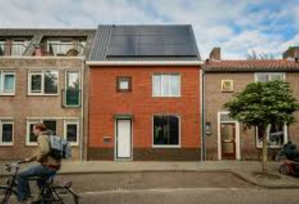
To tackle climate, we need to tackle homes
Our Approach
Improving social housing
Helping homeowners and landlords
42%
Waltham Forest Carbon Emissions (Kt CO2e, DESNZ))
Notes:
Transport 29%, Businesses 13%, Waste 12%, Public Sector 4%.
A simple version is 40/30/20/10 with 20=Business and Public Sector and 10=Waste

Slide 3
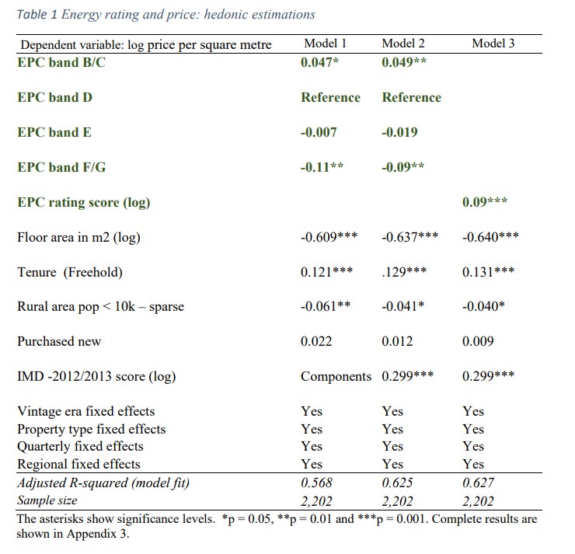
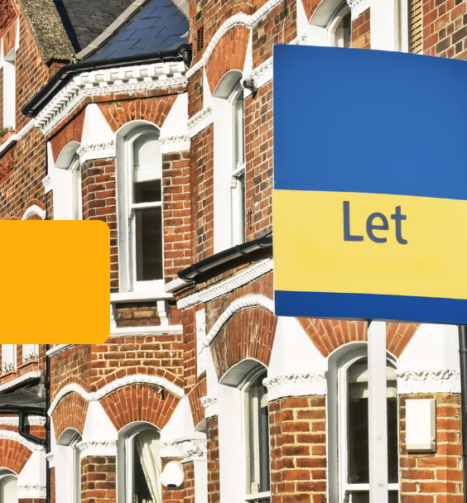
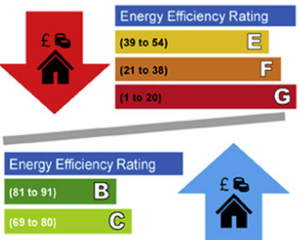
Reasons for upgrading the energy efficiency of homes
££

Slide 4
Now…and then slide
Barriers to upgrading the energy efficiency of homes
“It's not worth it as I don't get the savings”
Now
Expensive, may have money ‘locked’ up in property, may be a landlord and feel you will not recoup cost
Confusing,
Hassle,
No good suppliers,
Vision
Support early adopters
Retrofit Loan…
XX
Trusted advice service
HEWF
Network of past retrofitters
Making the green choice the easy choice
Supportive Planning
Free parking permits
No good suppliers
Retrofit Company
“It’s too expensive”
“It’s too confusing”
“It’s too much hassle”
“It’s too hard to find suppliers I trust”

Slide 5
What is your experience?
Notes:
https://app.sli.do/event/hnNa18rx4qWbFMVUis88Lb

Slide 6
3 options we are exploring
Energy Company Obligation (ECO4) – Energy companies have an obligation to help improve homes across the country. We could partner with them to try and help improve less energy efficient homes in Waltham Forest that are occupied by residents on benefits.
1
Energy Upgrade Loan – Cost often comes up as the largest barrier. Would a new low-interest or zero-interest energy upgrade loan help? This could be open to all private owners and £2,000-£20,000 for new measures (e.g. insulation, solar).
2
Greener planning – Could planning advice and rules that are more favourable for those making energy efficiency improvements help? This could include free energy assessments or fast-tracking applications.
3

Slide 7
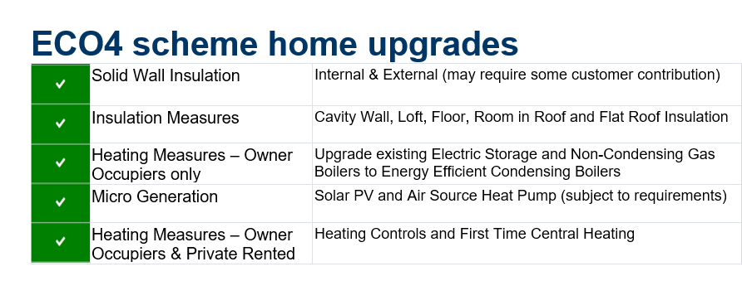
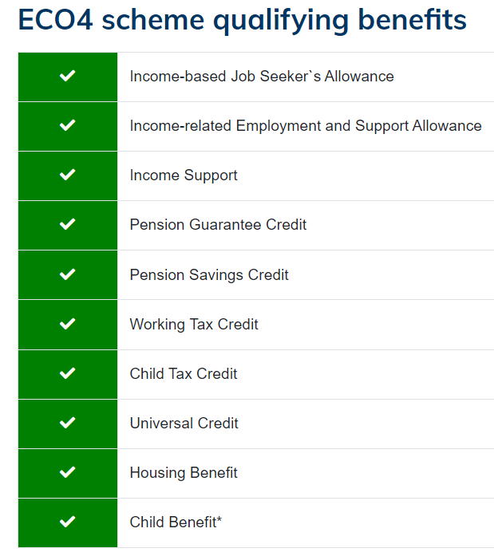
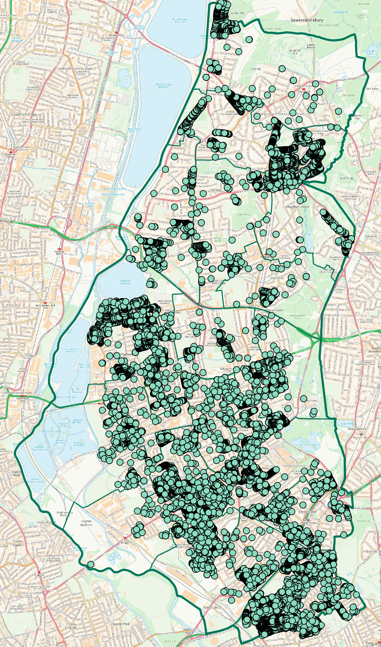
Energy Company Obligation (ECO4) – Energy companies have an obligation to help improve homes across the country. We could partner with them to try and help improve less energy efficient homes in Waltham Forest that are occupied by residents on benefits.
1

Slide 8
Home types in the borough
New
Owner-Occupiers
Private Rented
HAs
Council
Private
Ours
Other

Slide 9
Home types by CO2 emissions
New
Owner-Occupiers
Private Rented
HAs
Council
Private
Council
Other
Key:
Approximate Carbon Emissions

