Slide 1
The ASB Team Service Delivery Briefing

Slide 2
Background & Context
In 2019, the Council launched its first Anti Social Behaviour Strategy together with a detailed operational delivery plan. Key commitments have progressed including strengthening the Council’s ASB Service offer and enhancing our partnership working with the Police.
We have seen several improvements such as:
The customer journey for reporting ASB – ASB Chatbot (beta mode) & Firmstep online reporting form streamlined.
Closer working relationship with the Problem-Solving Policing Team (forming a virtual team) – Police Commendation received March 2022 for best practise on tackling cuckooed and problematic premises via Operation Monkash.
Parkguard ASB Patrol Service - implemented to conduct ASB Patrols across the borough with Police operating 7 days a week.
Successful Joint operations - including Op Monkash which focus on identifying properties/persons who are victims of cuckooing so safeguarding of the tenant can be implemented, and Op Moontwist which focus on identifying properties which are run as brothels. Once established the perpetrators can be issued a CPW, and LL informed or warned about the use of their property. This operation also focus on modern day slavery and sex trafficking.
Implemented & Refreshed Partnership Meetings – ASB Risk Assessment Conference (ASBRAC) focusses on victims of ASB and the Problem-Solving Partnership Meeting (PSPM) meets fortnightly attended by partners from Police, neighbourhoods, ASB and other services.
Supporting Residential Providers – As part of the Housing Compact via ASBRAC, PSPM, ASB Patrol service and Closure Orders
Performance monitoring - Power BI performance report for the ASB Team in place.

Slide 3
ASB Team Structure
Assistant Director of Enforcement & Safety
Lisa Jones
Head of Operations Centre
(Recruiting to post - Lisa Jones currently covering)
Head of Critical Incident Management & Emergency Planning
(Recruiting to post - Lisa Jones currently covering)
Commissioned Services
Victim Support
ASB Patrol Team
ASB SLA’s
Support to Residential Providers
Police Problem Solving Team
Multi-agency working
ASB Team Manager
Temitayo Oketunji
ASB Senior (North – Chingford/Highams Park)
Brian Nish
ASB Senior
(Central - Walthamstow)
James King
ASB Senior (South – Leyton/Leytonstone) Marta Wasinska
Victim Support Champion for ASB & Hate Crime
Hanife Ahmet
ASB Patrol Service (Parkguard)
(X5)
Police Problem Solving Team
(X3)
ASB Officer
Andrew Boot
ASB Officer
Elene Drayton
ASB Officer
Jason Bell
ASB Officer
Olayemi Labaeka
ASB
Officer
Judith
Ihonor
ASB Officer
Fred Angove
ASB Officer
Charlotte
Riley
ASB
Officer
Anabell Hassan

Slide 4
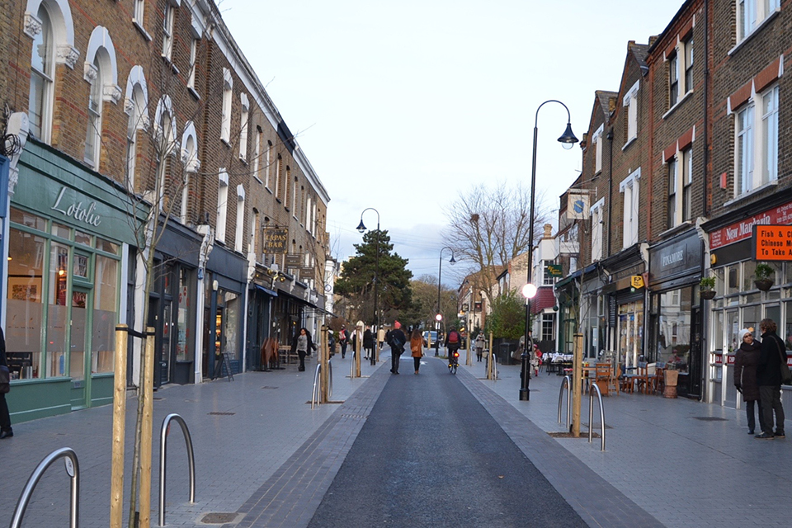
ASB Team Remit ASB in the Private Rented Sector ASB in Open Spaces PSPO Enforcement ASB Hotspot locations WF Housing Estates Problematic Premises (ASB) Problematic People (ASB) Premises Closure Orders Civil Injunctions Private Sector Landlords Regular update to PSHL team on their issues with tenants Look out for signs of - DV, modern day slavery, cannabis factories, harassment, waste disposal, general nuisance, subletting, overcrowding, ensuring that a correct licence is place, report issues to the ASB Team or PSHL team, carry out regular inspections to address disrepair issues, compliance with the licence terms and conditions

Slide 5
Enforcement actions
Powers under the ASB, Crime and Policing Act 2014
Informal actions/ early interventions
Mediation
Referral to other services
Warning letters
ABCs and PCAs
Formal actions
CPWs and CPNs,
FPNs
CBOs
Closure orders
Injunctions
Seizure
Possession of the property applicable to WF Housing

Slide 6
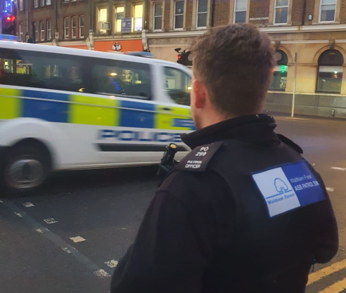
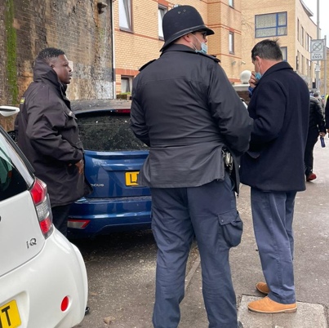
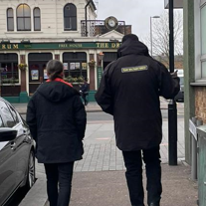
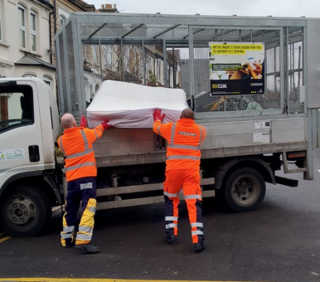
The ASB officers carry out various interventions in relation to ASB complaints -
Interview complainant and alleged perpetrator
Issue a warning letter to the alleged perpetrator or/ and landlord in response to a complaint against the tenants
Issue a community protection warning/notice to the tenant or/and landlord
Seek civil injunction at court
Premises closure order
Referral to other services such as VS, EH, MH, Social Services, and other
No further action due to lack of evidence

Slide 7
Case study
ASB issues in a licenced property

Slide 8
Licenced Property
Serious ASB issues perpetrated by tenants
Number of complaints received from Police and residents about comings and going, nuisance behaviour, loitering outside and drunken disorder
Premises referred to Op Moontwist for unannounced visit
A team made of ASB officers, Licencing, Police, Immigration, Sexual Health outreach manager carried out visit
Persons found at the property were interviewed, health checks were carried out, processed through immigration and police, relevant warnings were issued to persons involved in running a brothel
The Landlord was notified about the use of the property and agreed to work with Local Authority to put an end to the misuse of their property and provided supporting statement regarding the behaviour perpetrated by tenants
Closure Order of the property was sought at court and granted for three months excluding persons who were meant to live at the property
The Landlord proceeded with eviction of the tenants

Slide 9
Any questions?
How you can help?
How we can help?
How we can work together to resolve a problem?

